Slide 1

Applied Distributed Systems
Networking 2
Notes:
1

Slide 2
Overview
TCP and Ports
Firewalls and subnets

Slide 3
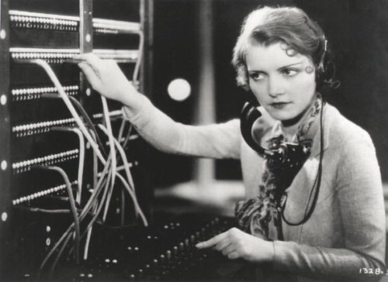
Ports
Hotel switchboard
Hotel has a phone number that rings at a switchboard
Switchboard operator then connects incoming call to a phone in a particular room

Slide 4
Computer ports
Similar to hotel switchboard
Application listens on a particular port
Message comes to the Virtual Machine and is placed on a particular port.
Application gets that message
Known ports for standard applications. E.g. 80 for http

Slide 5
Ports and IP addresses
IP addresses say where on the internet a computer (virtual or real) lives.
They are machine specific and controlled by the Internet Protocol (IP)
A port describes how to route a message to a particular application.
They are application specific and specified in a message by the Transmission Control Protocol (TCP)
To send a message to a particular application on a particular machine both IP addresses and ports are used (TCP/IP)

Slide 6
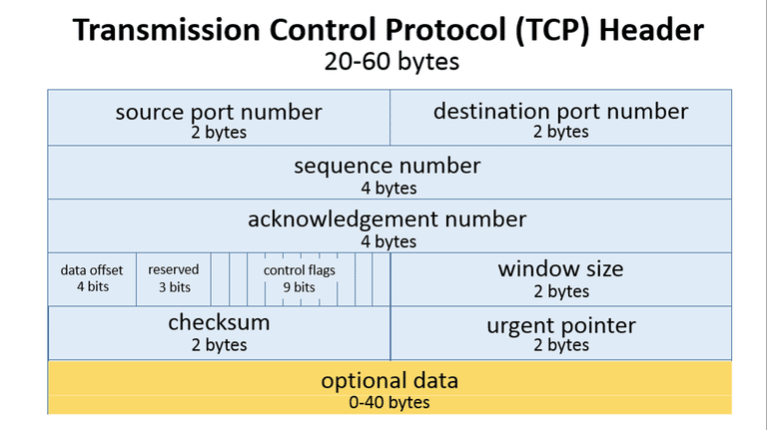
Transmission Control Protocol (TCP)

Slide 7
Port forwarding
Two applications listening on the same port may cause a message destined for one application to be sent to another.
Port forwarding tells a routing computer that a message specified for one port should actually be delivered to another.
Message for destination application on port A
Message for destination application on port B
Routing
computer
Destination
application

Slide 8
Applications and ports
Applications listen on a particular port but …
they may need to listen on a different port than originally specified because of contention.
Applications may be parameterized to specify which port they listen on.
Observation – applications specify which port they listen on but not which ip address their host has.

Slide 9
Ports, bridged networks, VMs and Containers
Ports are managed by the operating system. It decodes a message and routes it to the correct application.
Each VM has its own operating system so it is possible to have two VMs on a bridged network each using the same port number.
Containers share an operating system so two applications on a container bridged network cannot use the same port number.

Slide 10
Overview
TCP and Ports
Firewalls and subnets

Slide 11
Firewalls, Proxies, Gateways
Technically, there is a difference between the terms firewall, proxy, and gateway.
In practice they are frequently used interchangeably
One software system may play multiple roles as firewall, proxy, or gateway.
The distinctions are about to be defined

Slide 12
Firewalls
Firewall – monitors incoming and outgoing network traffic and permits or blocks data packets.
Firewalls are configured by specifying rules:
allow or disallow message based on ip address of recipient or sender
route allowed message based on port number. E.g. messages specifying port 80 are sent to http server.
,

Slide 13
Proxy server
A proxy server makes web request on your behalf, collects the response from the web server, and forward the results back to your system.
The effect is to hide your IP address from the outside world.

Slide 14
Gateway
Gateway – anything that hides access to a complex set of components E.g. access to the cloud is through a gateway.

Slide 15
Demilitarized Zone (DMZ)
Typically an organization distinguishes between information publicly available and that maintained within the organization.
An intranet is a private network used by an organizaton
A DMZ is an area guarded by a firewall that allows external access although not external modification
A separate firewall allows access from the DMZ into the intranet.
Web servers and Virtual Public Network servers are located in the DMZ
© Len Bass 2015
15

Slide 16
Virtual Private Networks
Imposes private network on top of public network
Uses “tunneling” server located in DMZ
A user logs on to tunneling server, it verifies the users credentials and allows access the intranet.
Messages to the VPN are encrypted and passed through the firewall into the intranet.
© Len Bass 2015
16

Slide 17
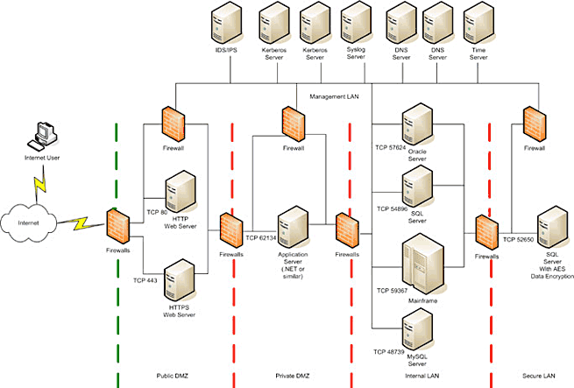
A typical Network architecture
17
https://www.google.com/url?sa=i&rct=j&q=&esrc=s&source=images&cd=&cad=rja&uact=8&ved=0CAMQjxxqFQoTCMDlpMOT48gCFQlyPgodTPQOjA&url=http%3A%2F%2Farchitecturebestinfo.blogspot.com%2F2015%2F09%2Fnetwork-architecture.html&psig=AFQjCNGyb2y-UIuC91f9HLcL9uN9DGCLWQ&ust=1446051703304951
Notes:
17

Slide 18
Networks have subnets
A subnet is a logical portion of a network.
It is used to divide the network into groups.
Allows better management of traffic for network administrator
Each group
Has its own access rules
Can be protected by a firewall
© Len Bass 2015
18

Slide 19
Summary
Ports are means for routing messages between applications.
Firewalls, proxies, and gateways are access points both from outside and internally within a network
Notes:
19

